Slide 1

Scheme/LISP A functional and dynamically typed language with good support for lists and higher order functions.
1975
CMPT 383
Summer 2022
SFU Surrey
LISP: 1958

Slide 2
What was going on in 1975?

Slide 3
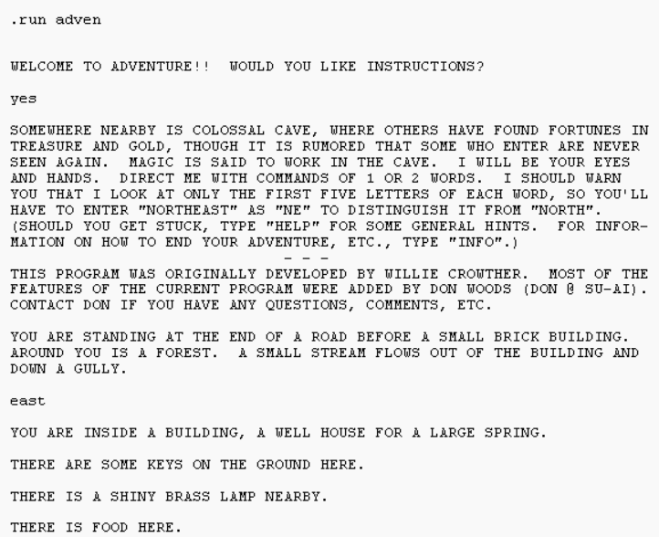
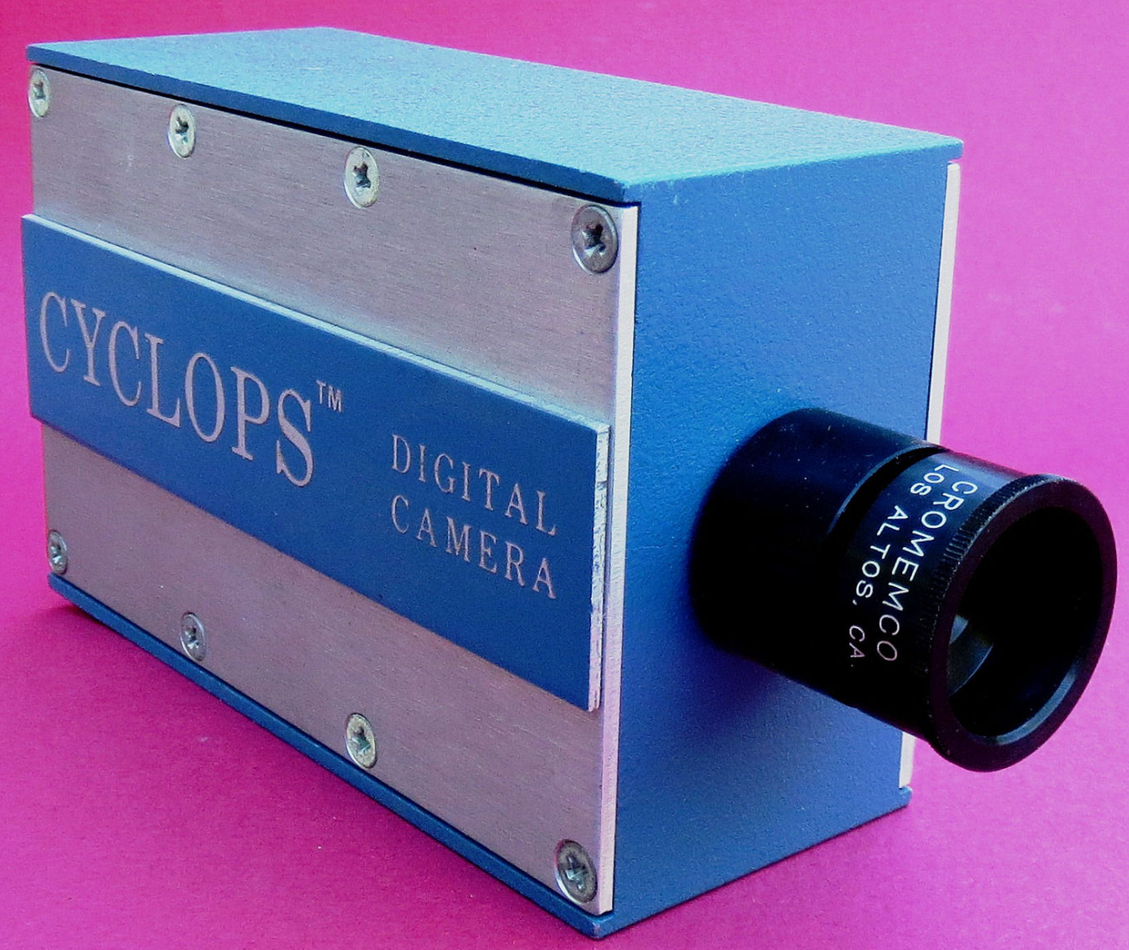
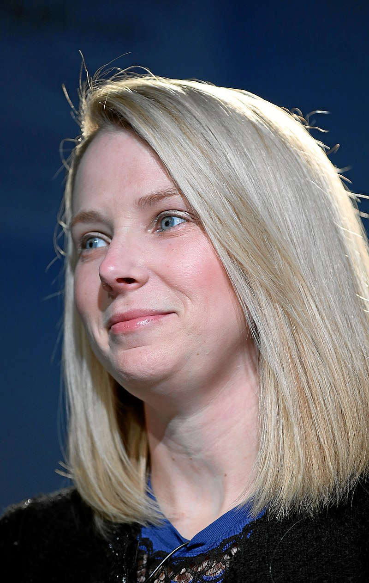

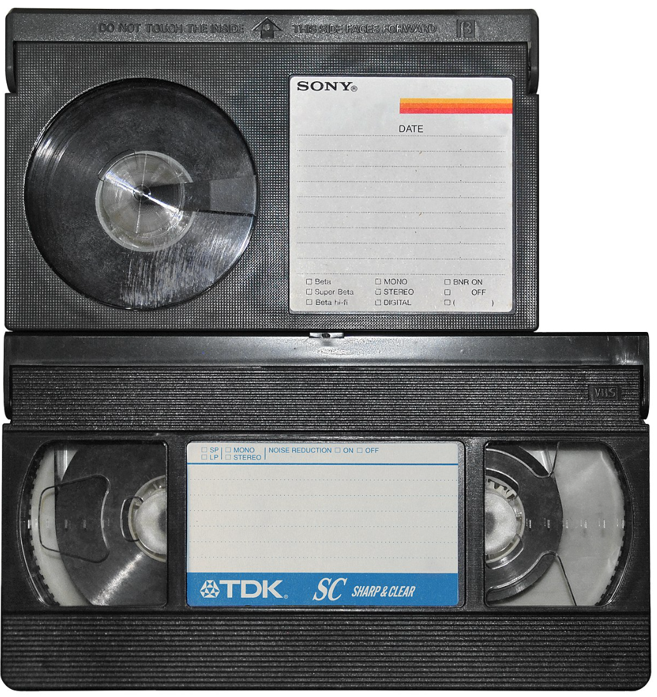
1975: First Appearances
Cromemco Cyclops
First all-digital camera
32x32 pixel resolution
Marissa Meyer
Tech businesswoman
Colossal Cave Adventure
First text-based role-playing game
Betamax and VHS Consumer video recorder formats

Slide 4
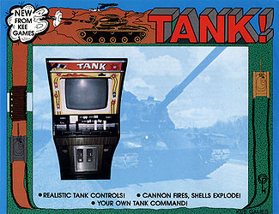
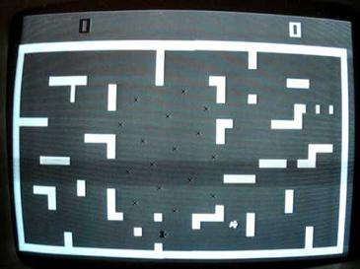
1975: Highest-grossing Arcade Game
Tank / Tank II Kee Games (Atari)

Slide 5

1975: Highest-Grossing Movie
Jaws

Slide 6
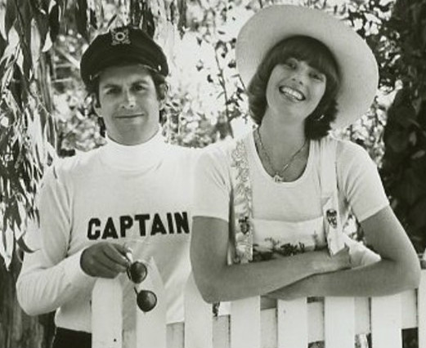

1975: Most Popular Song
Love will Keep us Together
Captain and Tennille

Slide 7
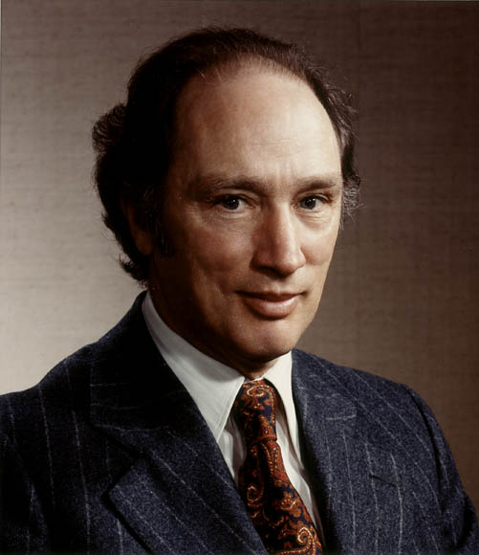
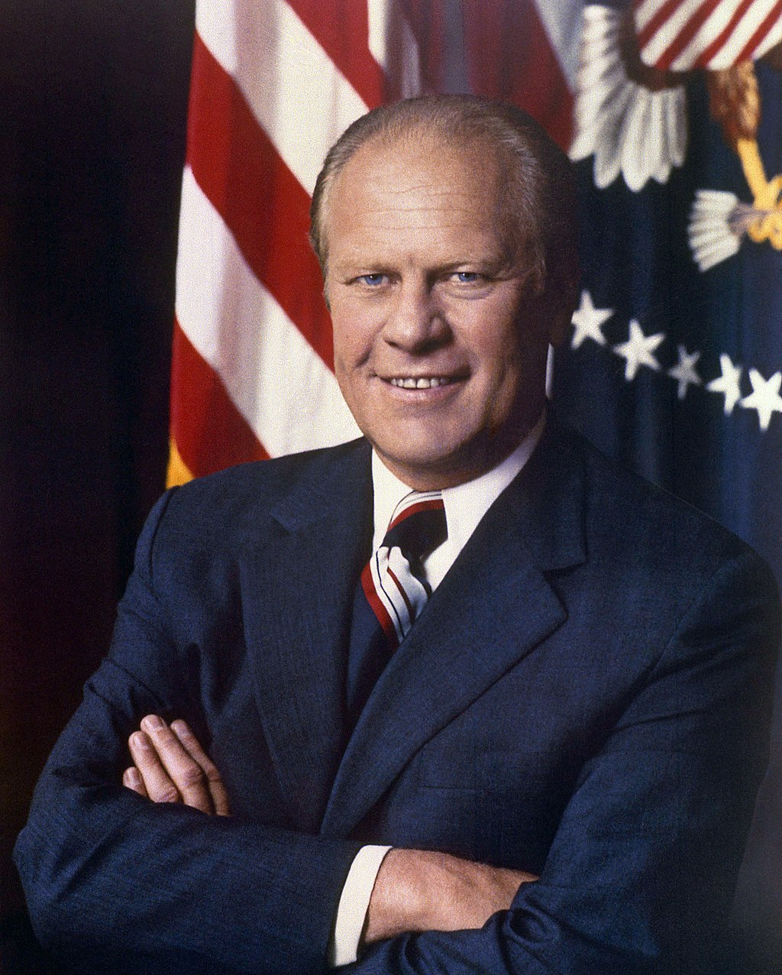
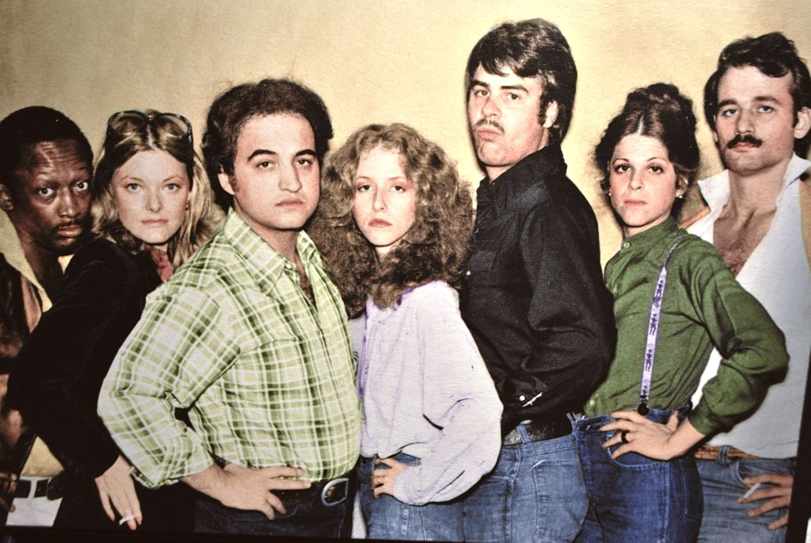
1975
Canadian PM
US President
This TV show started
Pierre Trudeau
Gerald Ford
Saturday Night Live

Slide 8
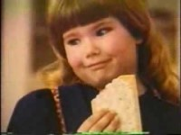
1975
Milton the talking toaster
sold Pop Tarts

Slide 9
LISP 1958
Scheme 1975
Racket ~1995

Slide 10
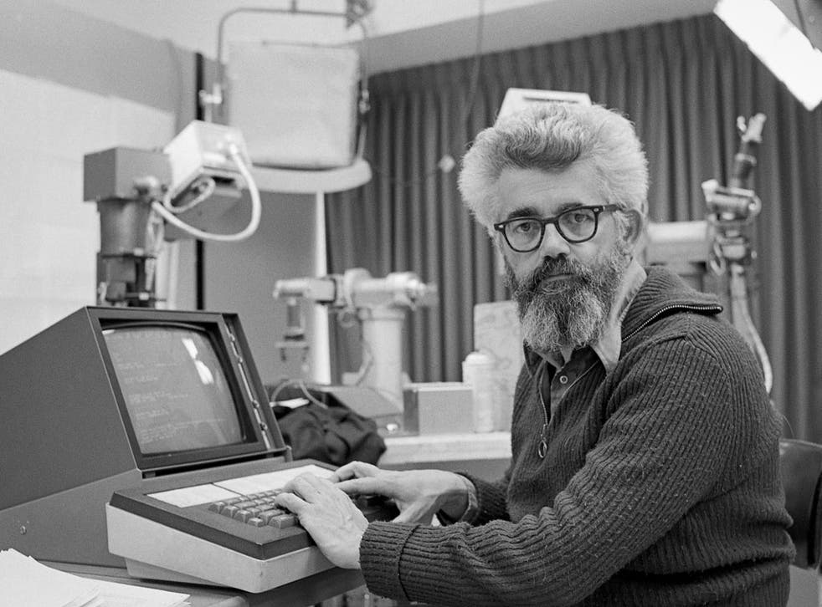
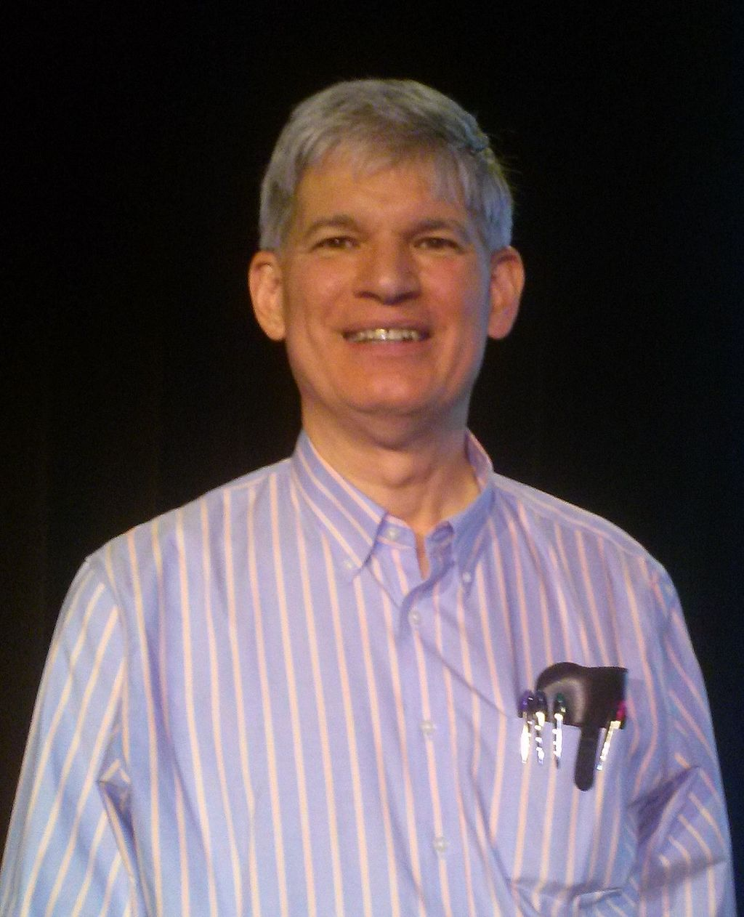

LISP and Scheme’s Original Designers
John McCarthy (1927-2011)
Original designer of LISP (1958)
Guy Steele and Gerald Sussman
Original designers of Scheme (1975)
Also coined the term “Artificial Intelligence”, and for many years was a leading AI researcher.
Racket can be thought of a modern dialect of Scheme, with many new ideas added.

Slide 11

Scheme Probably Can’t Get You a Job!
The original version of JavaScript was implemented as a Scheme-style language, before being modified to look more C-like.
It’s mostly a research language used by a subset of academic programming language researchers.
A variation of LISP called Clojure has more recently gained some popularity for practical programming (but it’s still pretty niche compared to other languages)
Clojure

Slide 12
What’s Scheme/LISP Good for?
Popular in traditional “symbolic” AI research.
Packed with all kinds of interesting ideas, many of which have inspired more mainstream languages.
A good language for writing other programming languages and programming language tools.

Slide 13
What’s Scheme Not so Good For?
Measuring the performance of different programming languages is surprisingly difficult to do fairly. Check out the Computer Language Benchmarks Game.
Scheme is generally not as efficient as other languages.
Dynamically typed
Reliance on singly-lists the core data structure
Scheme is not used much in practice, so it can be hard to find support for it.
Scheme’s notation is simple, but maybe too simple. ()-style notation results in lots and lots of parentheses, which many programmers dislike.

Slide 14
Major Features of Scheme
Functions are first-class objects
Functions can be passed and returned (including closures)
Interpreted
Easy to evaluate individual expressions
Memory-safe and garbage-collected
No dangling pointers, no manual memory deletion
Homoiconic
Scheme programs are written as Scheme lists
Flexible
Powerful macro system allows for major changes to the language

Slide 15
Major Features of Scheme
Types
Dynamically typed, i.e. types checked at run-time
Symbols Lists are the key data structure
Continuations
Lexical Scoping
One of the first languages to fully implement the lexical scoping rules for names we now take for granted
Tail Recursion
Tail-recursive functions are automatically optimized into loops

Slide 16
Major Features Not in Scheme
Features not part of Scheme
No type declarations
No pointers
No built-in notion of object-oriented programming

Slide 17
Hello, World!
;; hello_world.rkt
(print "Hello, world!")
Download and run this in the DrRacket IDE. We’ll use both the interpreter and file editor in DrRacket.

